Slide 1
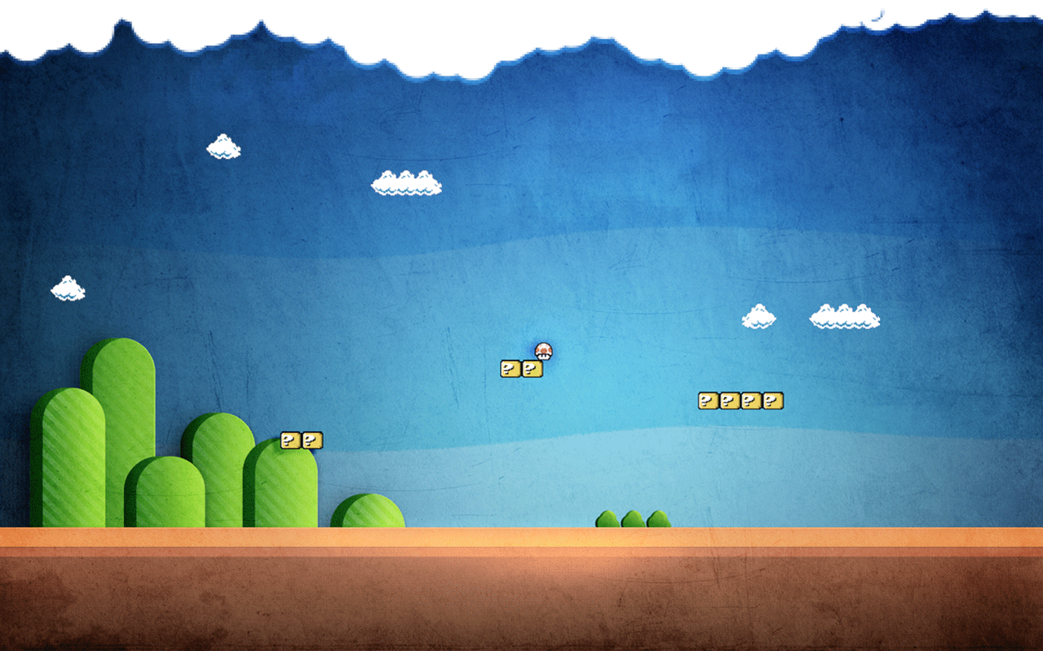

UNIVERSITEIT VAN AMSTERDAM
Super Mario Level Generation and Player Profiling
George Viorel Vișniuc
Efstathios Charitos

Slide 2


UNIVERSITEIT VAN AMSTERDAM
Live procedural content generation
Generate content in response to the player`s behaviour

Slide 3

UNIVERSITEIT VAN AMSTERDAM
Motivation
Implementation
Tests and Results
Conclusion & Future Work

Slide 4

Motivation
UNIVERSITEIT VAN AMSTERDAM
Trend to make games personal
Trend to use procedural techniques

Slide 5
Motivation
UNIVERSITEIT VAN AMSTERDAM
Procedural Content Generation
Time saving technique for game developers
Automated method, decreases work load of level designers
Can generate massive amounts of game content
Starting point for incorporating player profiling
Player Profiling
Model player experience, tailor it to the player
Player`s geographical and cultural background, age, sex etc.

Slide 6
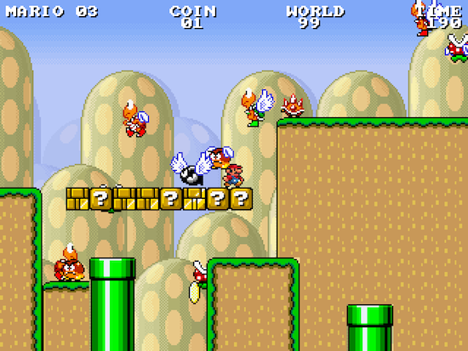
Implementation: Mario Infinity Engine
UNIVERSITEIT VAN AMSTERDAM
Takes as input controllable parameters
Difficulty
Max. coins, enemies etc.
Gathers player statistics
Deaths
Kills
Goal: Live generation of content based on statistics

Slide 7


Implementation: live content generation
UNIVERSITEIT VAN AMSTERDAM
Old level generator
New
G
G

Slide 8
Already completed segment
Current being played segment
Segment still to be generated based on assessments of the player experience

Slide 9
Implementation: statistics gathering
UNIVERSITEIT VAN AMSTERDAM
Statistics are gathered per level “block” by the engine`s Data Recorder.
Translate to Player Experience ( Togelius et al )
Fun
Challenge
Frustration
Use as Reward Function for SARSA learning agent that will explore the available parameter space.

Slide 10
Implementation: state space
UNIVERSITEIT VAN AMSTERDAM
Choose parameters to use as state space.
Confine to a subspace , that give acceptable levels.
Concentrate even more with by training on different target groups.
Final game - subtle responses to player behavior.
max coins
difficulty
difficulty

Slide 11


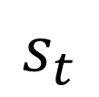
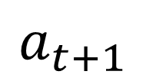

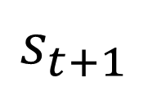
Implementation: sarsa
UNIVERSITEIT VAN AMSTERDAM
$$s_{t+1}$$
R
$$r_{t}$$
statistics
Agent
$$s_{t}$$
$$a_{t+1}$$
$$a_{t}$$
G
next block

Slide 12
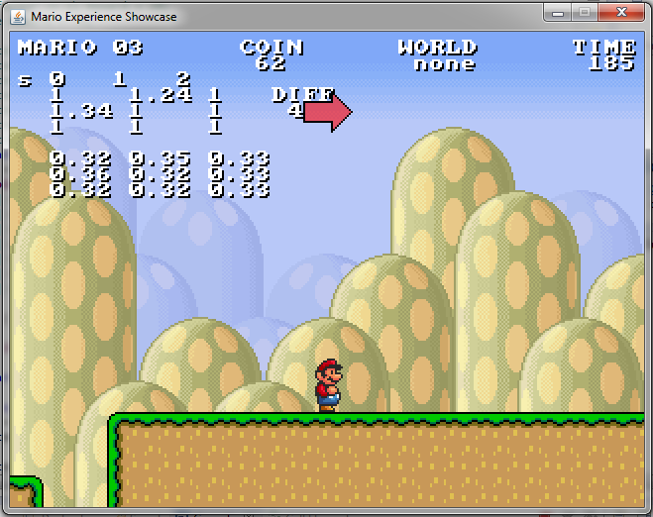
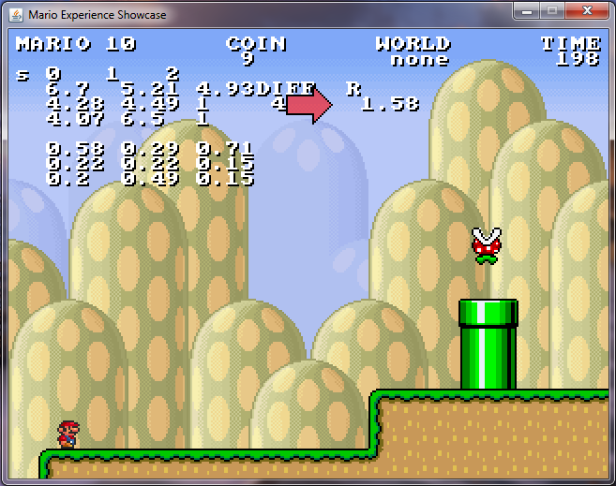
Testing : functionality
UNIVERSITEIT VAN AMSTERDAM
difficulty

Slide 13
UNIVERSITEIT VAN AMSTERDAM
Drawbacks for Testing
Big Time-step , Every Level Block
Unstable Reward Function
Need for game designer input and crowd sourcing for further tests.
Testing : outcome

Slide 14
Future Work
Different Learning Algorithm
Directly Acquire player emotions
Expanding - Changing the state space

